Slide 1

Healthcare Monitoring System for Chronic Diseases
Under Supervision of:
Dr. MONA ARAFA
Eng. Abdallah El-Ghamry

Slide 2


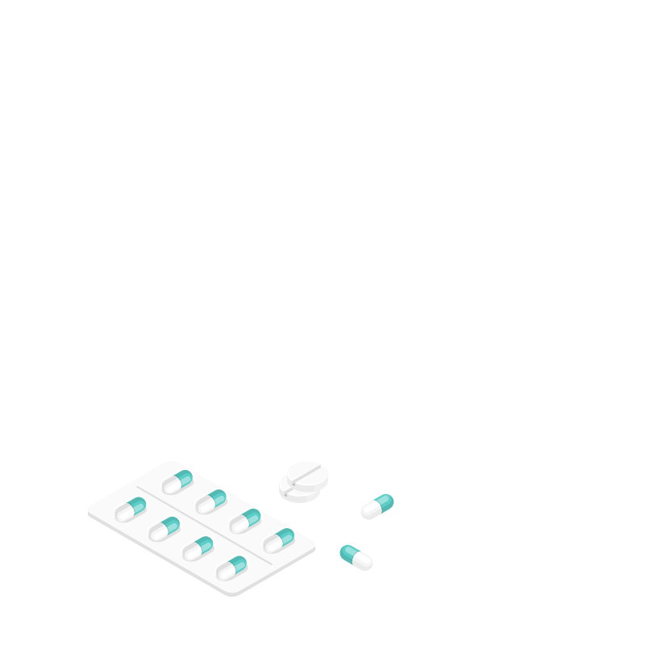
OUR TEAM Members
1
Ibtsam Mohammed Khattab
4
Jihad Gamal Mohamed
2
Alaa Ibrahim Mahfouz
5
Rawan Saeed Mohamed
3
Basma Ibrahim Yassin
6
Mohamed Ibrahim Zayed

Slide 3

Problem Definition
Chronic Diseases
About 70% of deaths in Egypt are due to chronic diseases including diabetes, heart disease, stress and cancer according to WHO in 2020
Epidemic Periods
Overcrowding In Hospitals

Slide 4
Telemedicine
Enables video or phone appointments between a patient and their health care practitioner
Telemedicine allows healthcare providers to evaluate, diagnose, inform and treat patients without an in-person visit

Slide 5
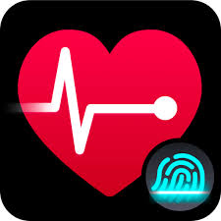


Examples on current telemedicine applications

Slide 6
We focus on
Diabetes Of All Types
Chronic Kidney
Disease
(CKD)
Coronary Heart
Disease
(CHD)

Slide 7
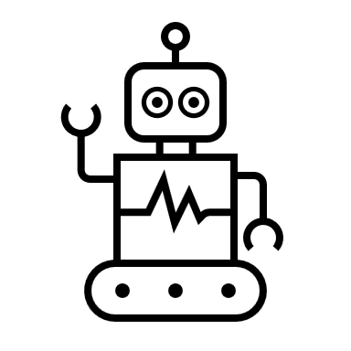
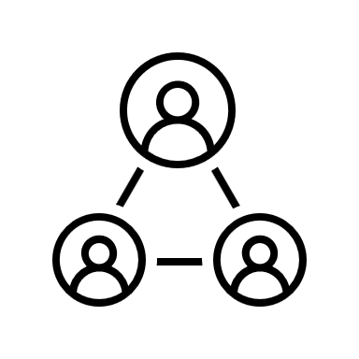

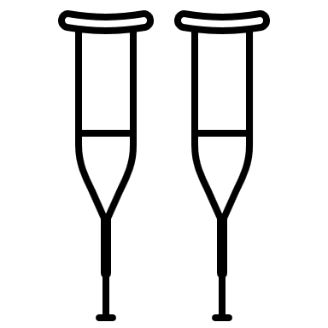
Patient
Interface
Sensors given to patient
Services
Relatives
Doctor
Interface
Machine Learning Model
Lab Tests

Slide 8
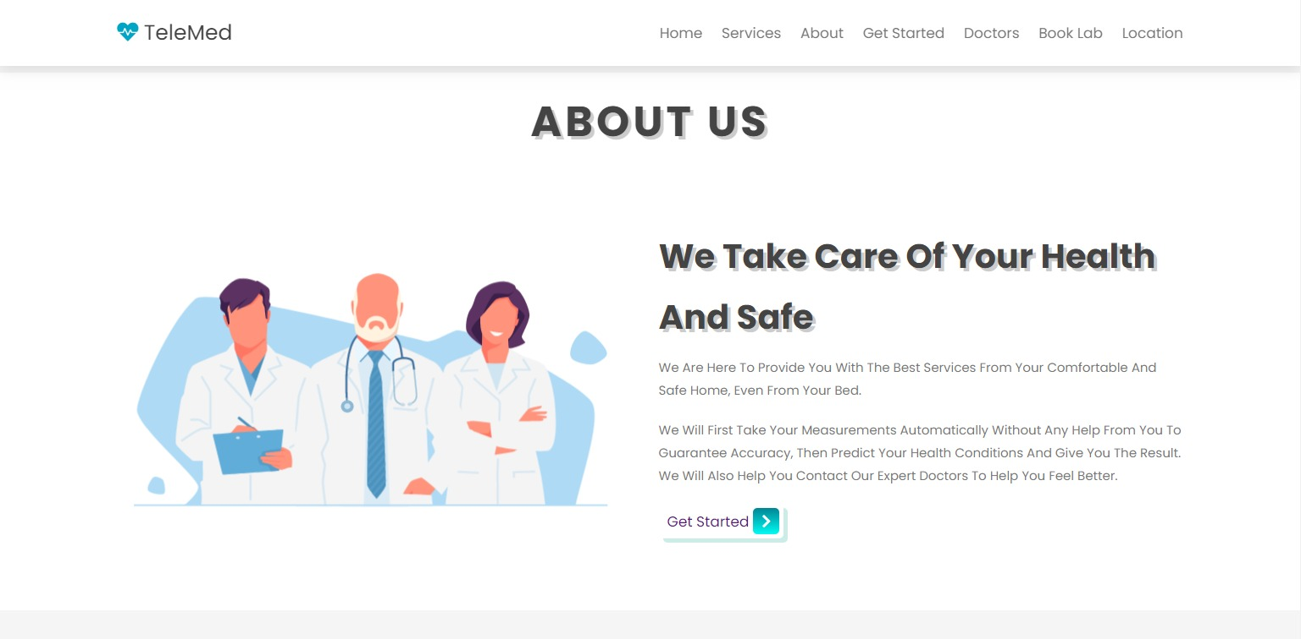
Website Home Page

Slide 9
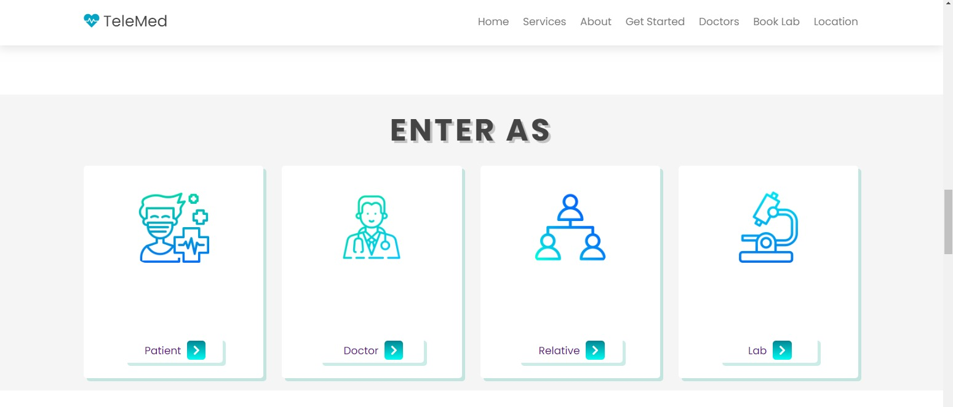
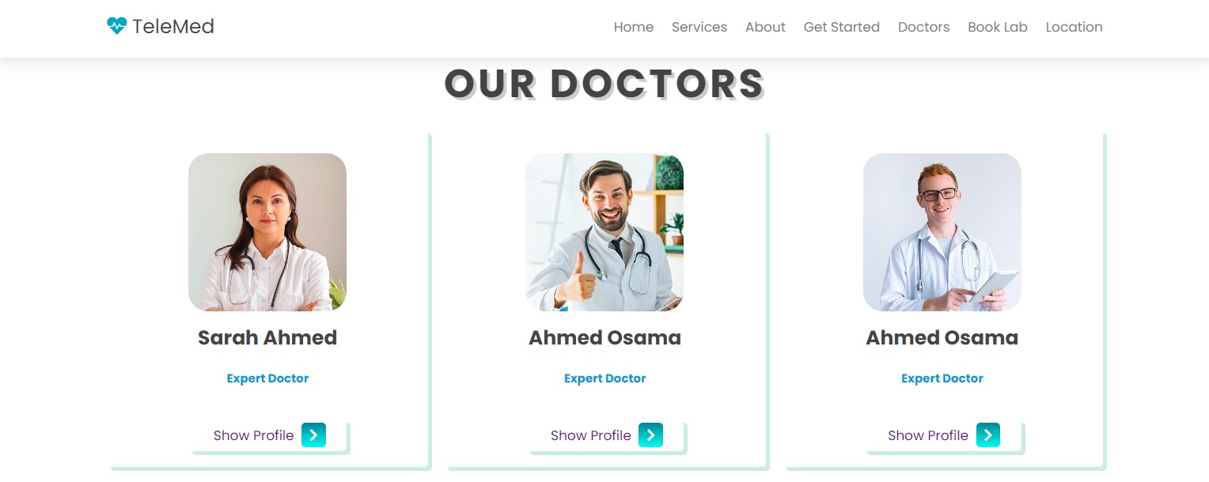
Website overview

Slide 10
Patient
Interface
Sensors given to patient
Services
Relatives
Doctor
Interface
Machine Learning Model
Lab Tests

Slide 11
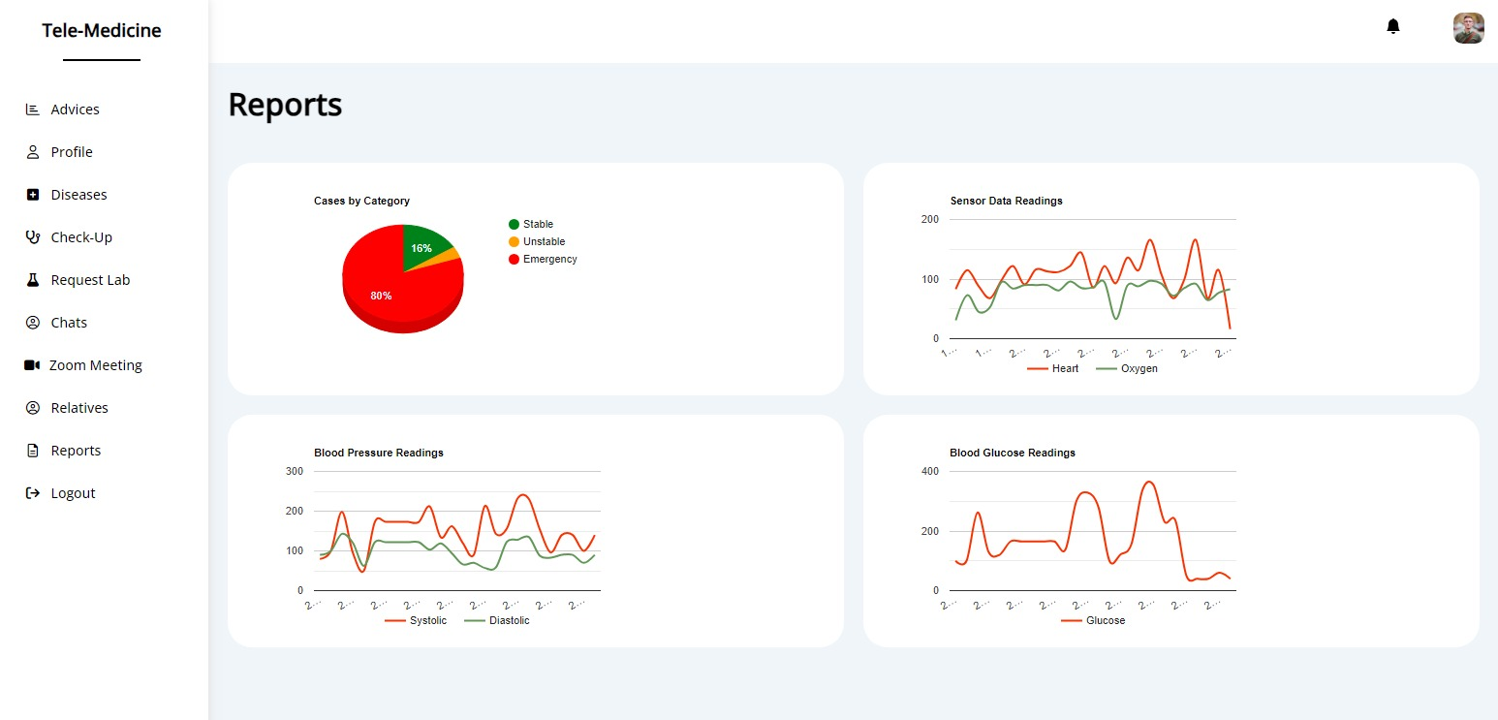
Following up Patient
Summarized view of patient’s health condition in Reports

Slide 12
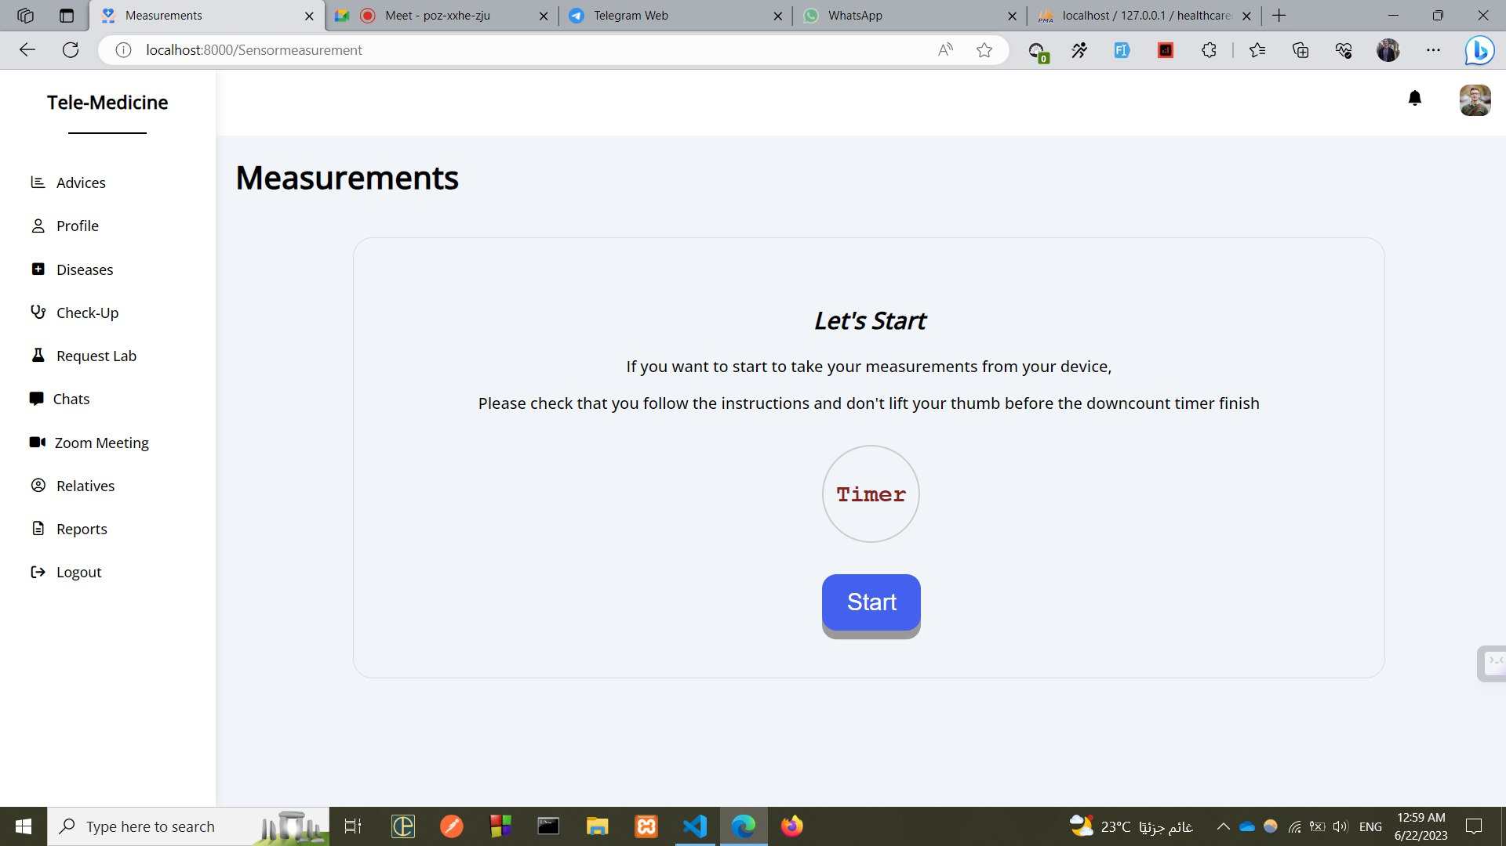
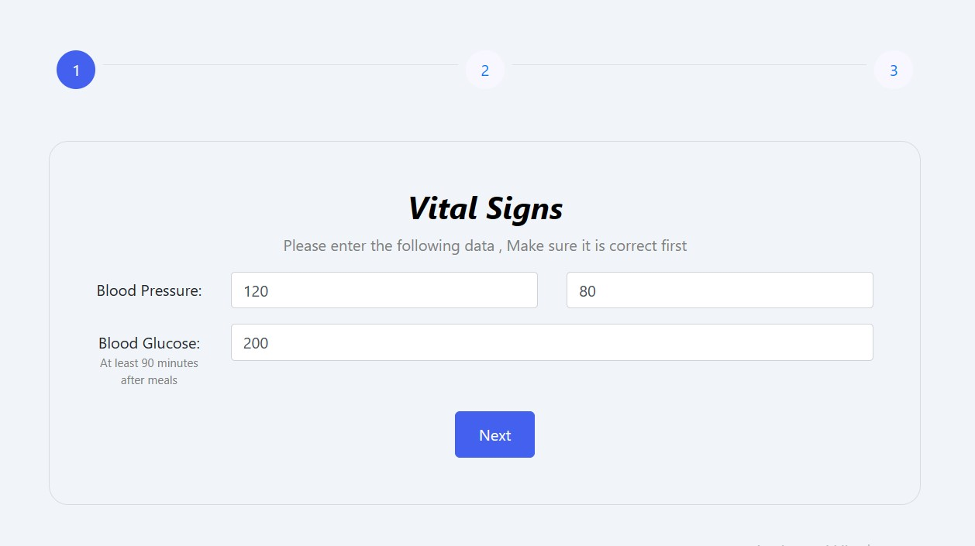
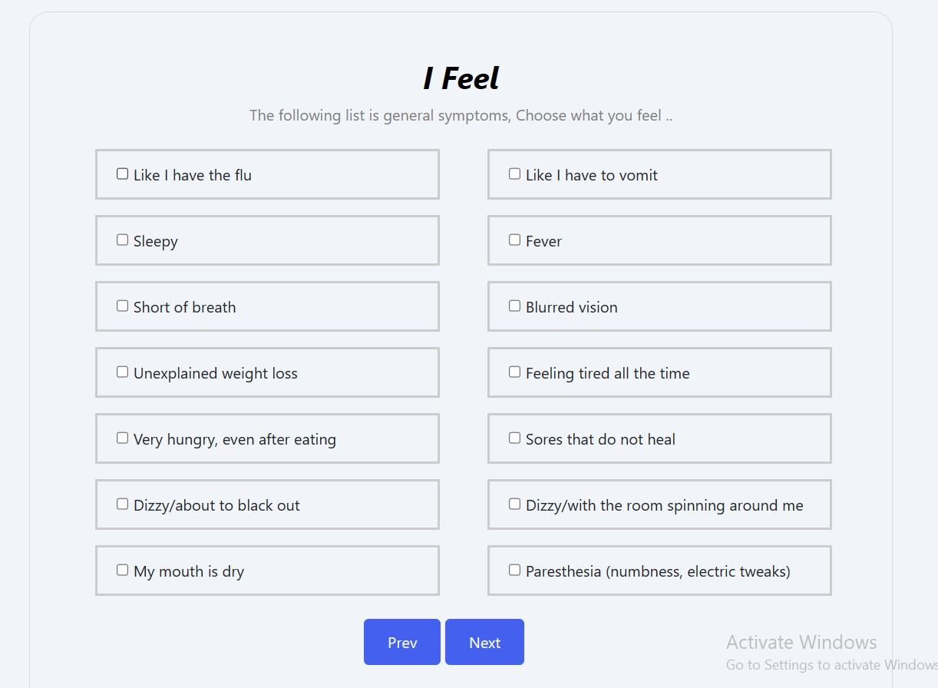
Start Uploading your Vital Signs

Slide 13
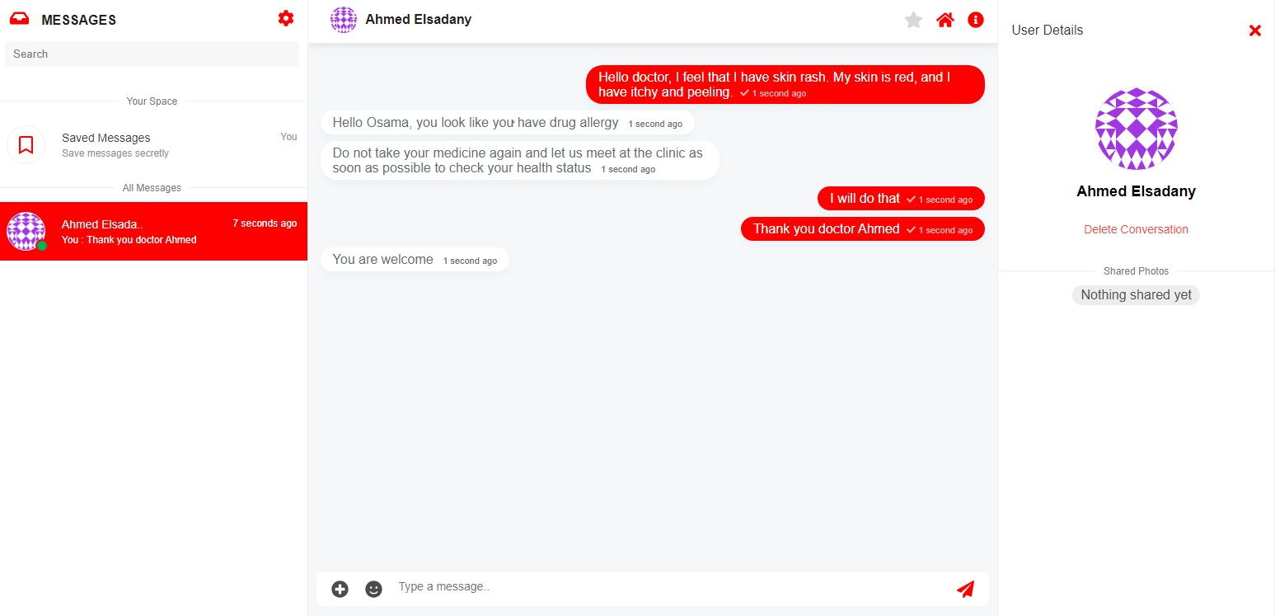
Communicate with your Doctor
“CHAT”

Slide 14
Patient
Interface
Sensors given to patient
Services
Relatives
Doctor
Interface
Machine Learning Model
Lab Tests

Slide 15
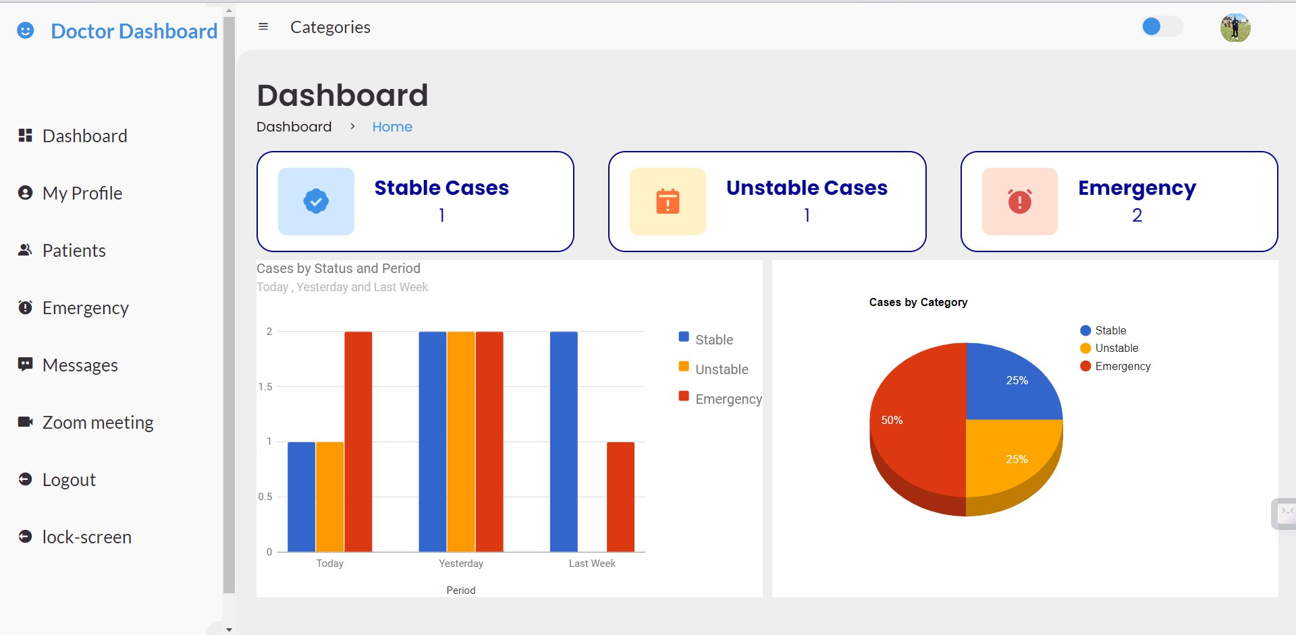
Doctor Dashboard
Monitor your patient’s health condition

Slide 16
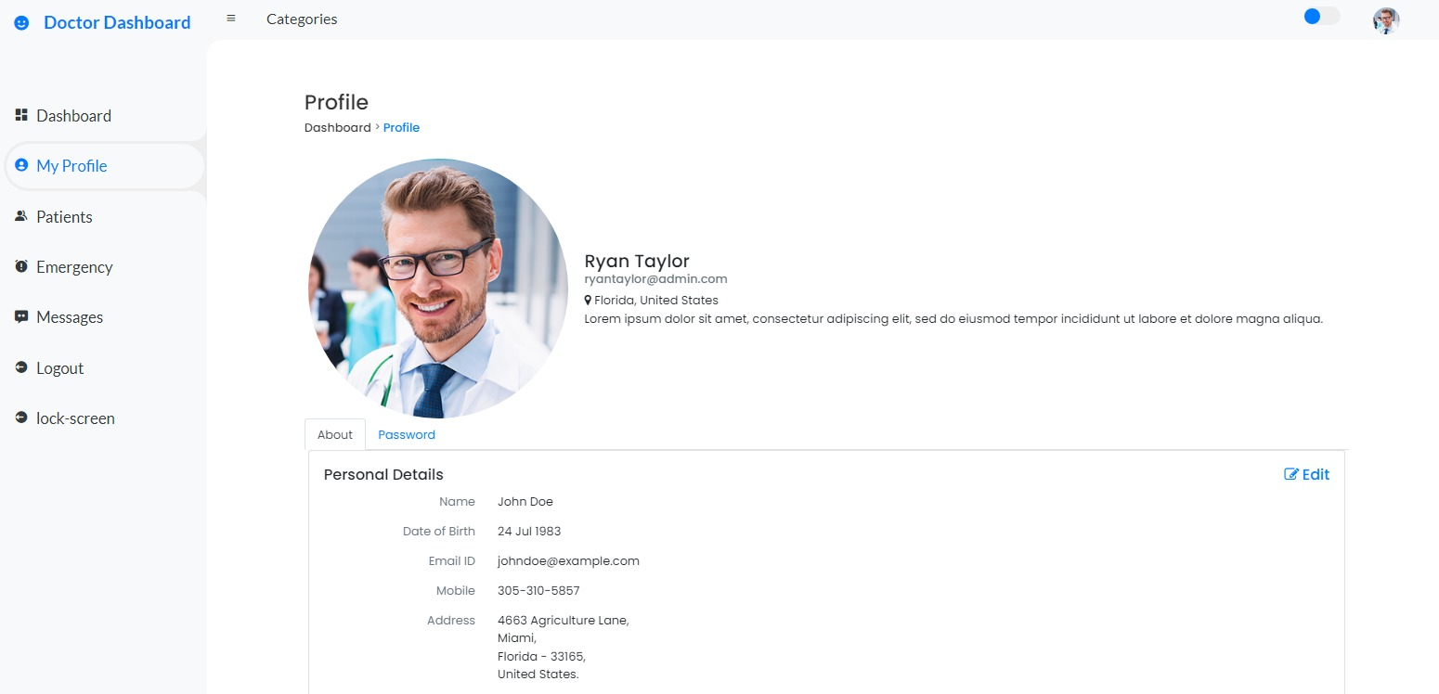
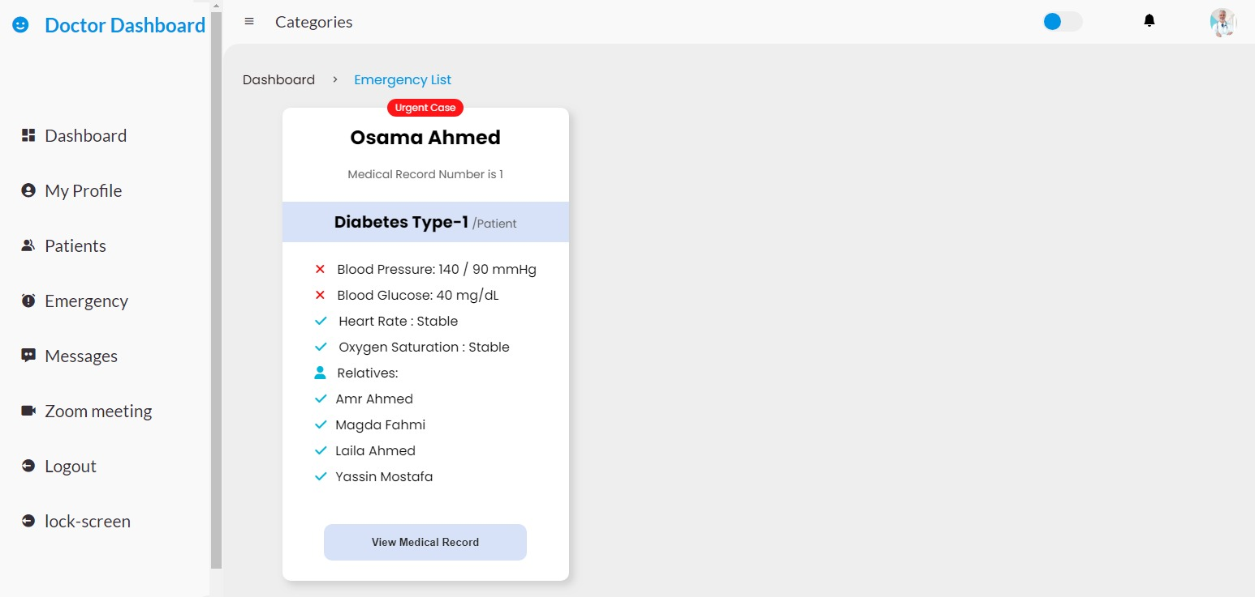
More Functions for Doctors
Doctor’s Profile
Quick Access Emergency List

Slide 17
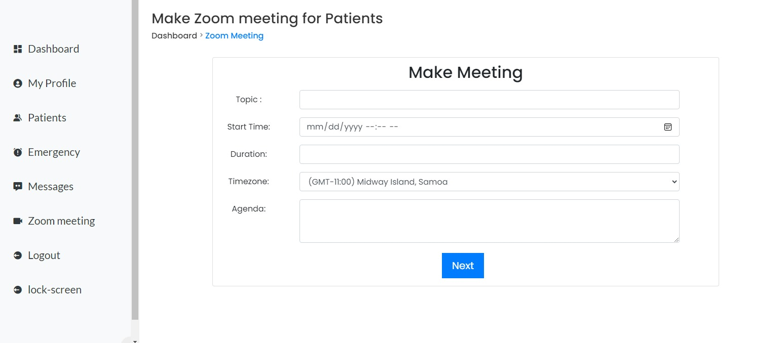
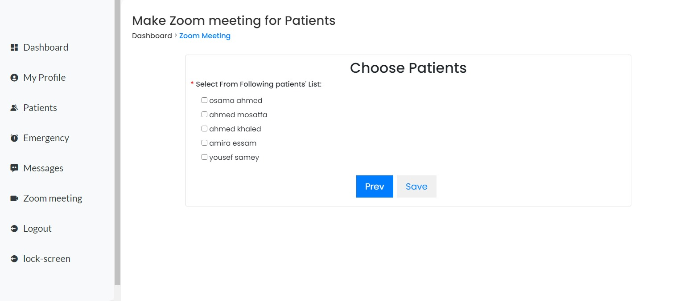
“ZOOM meetings”

Slide 18
Patient
Interface
Sensors given to patient
Services
Relatives
Doctor
Interface
Machine Learning Model
Lab Tests

Slide 19
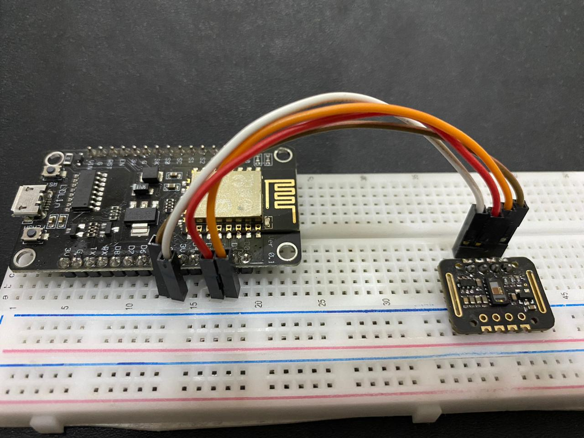
Sensors given to our patient based on his disease
According to the latest WHO data published in 2020 Coronary Heart Disease Deaths in Egypt reached 173,871 or 32.40% of total deaths.
Nodemcu (ESP8266)
Max30102

Slide 20
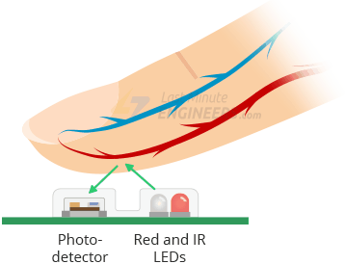
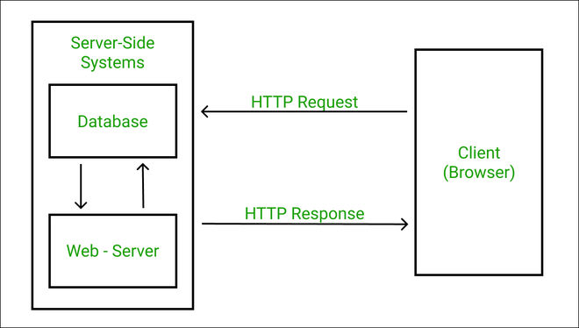
How Does it Work!
Measuring the amount of reflected light using a photodetector (SPO2)
changing volume of blood vessels, the LED light is changed (Heart Rate)

Slide 21
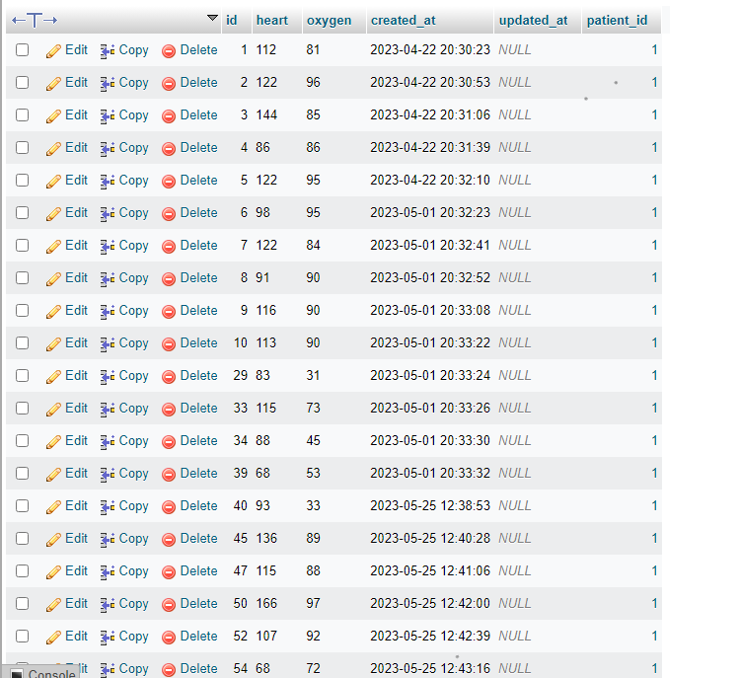
Readings uploaded to DB
Checking these measurements to specify patient’s condition:
Stable .. Emergent

Slide 22
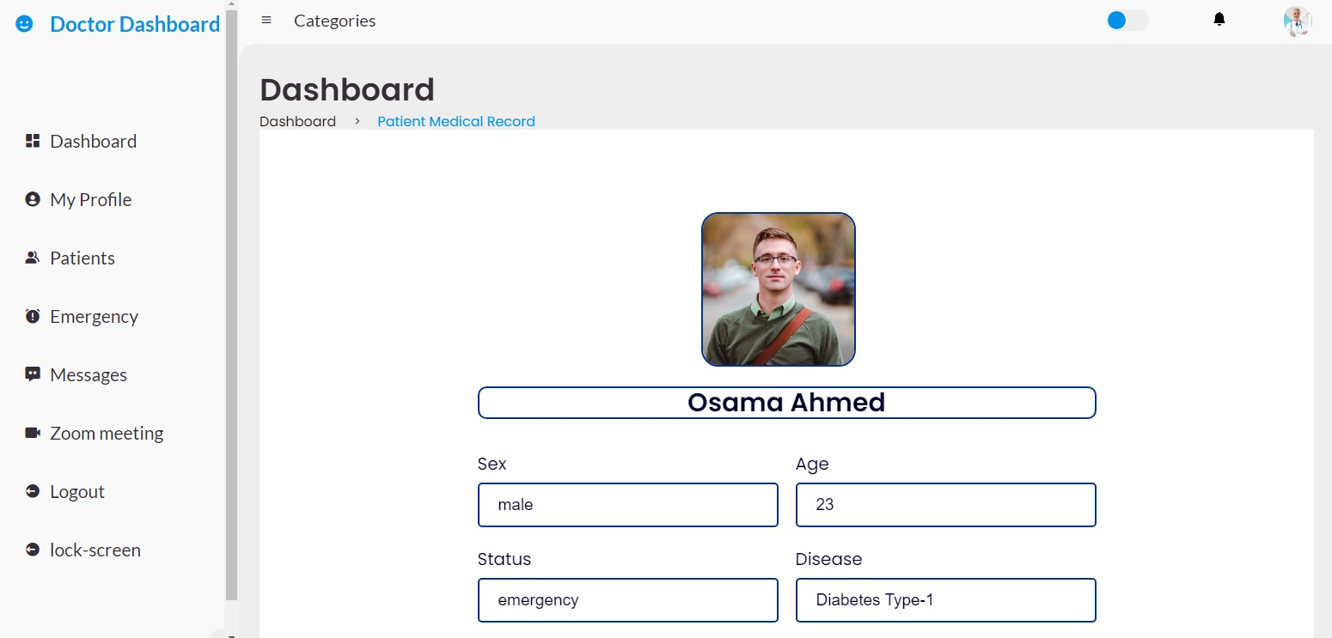
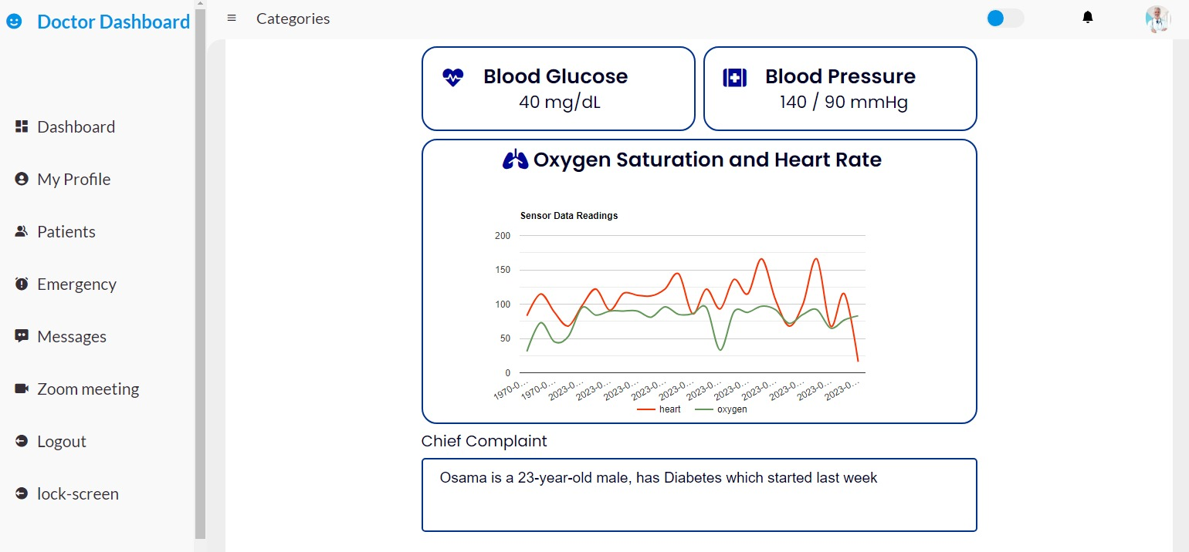
Medical Report
detailed report about patient’s case
Take appropriate action

Slide 23
Patient
Interface
Sensors given to patient
Services
Relatives
Doctor
Interface
Machine Learning Model
Lab Tests

Slide 24
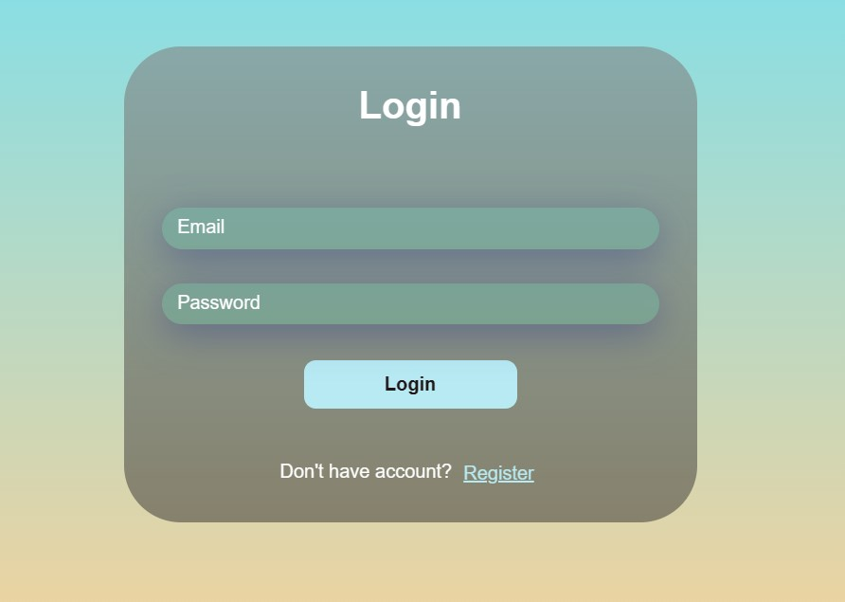
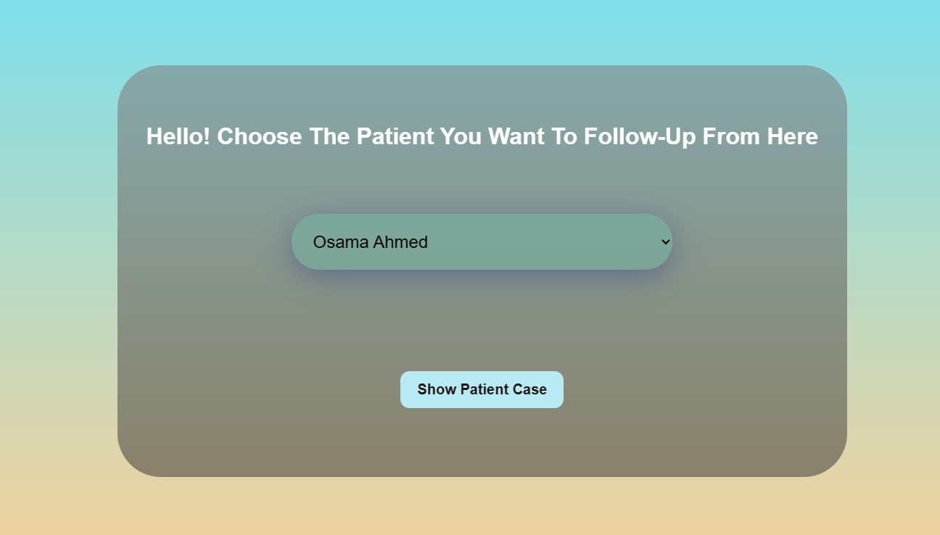
Enter as A Relative
Login to Start Monitoring
Select Your Patient

Slide 25
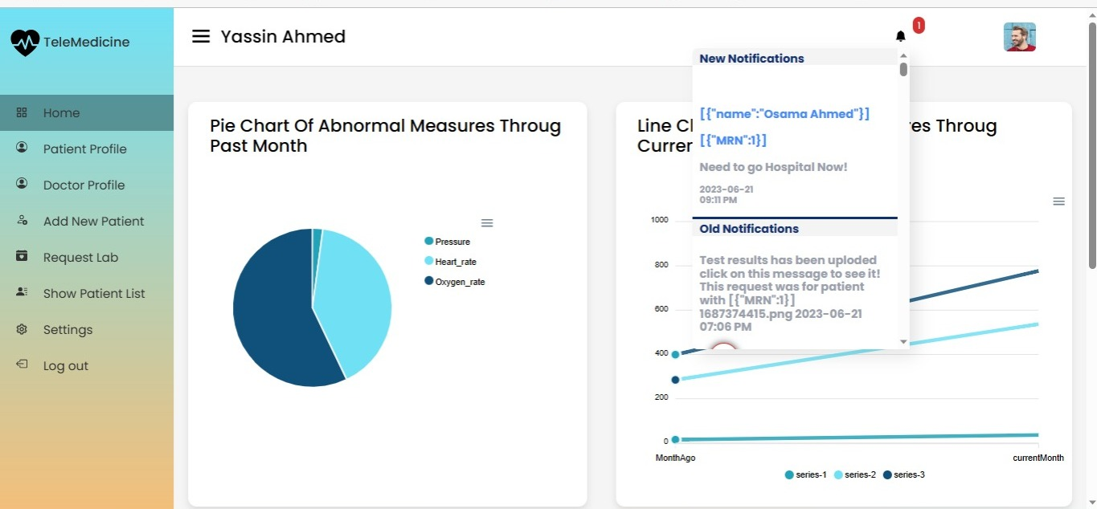
Relatives Dashboard
Summary of his patient’s health condition using Charts
Checking patient’s case anytime

Slide 26
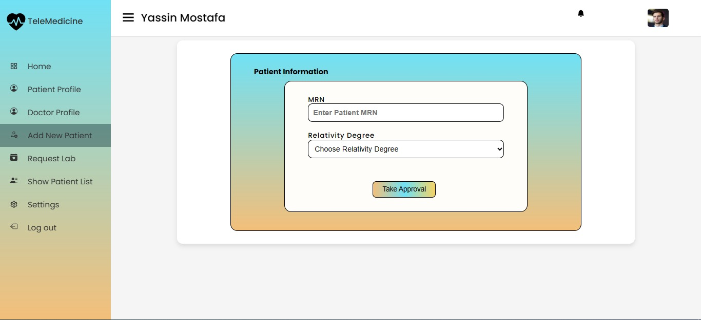
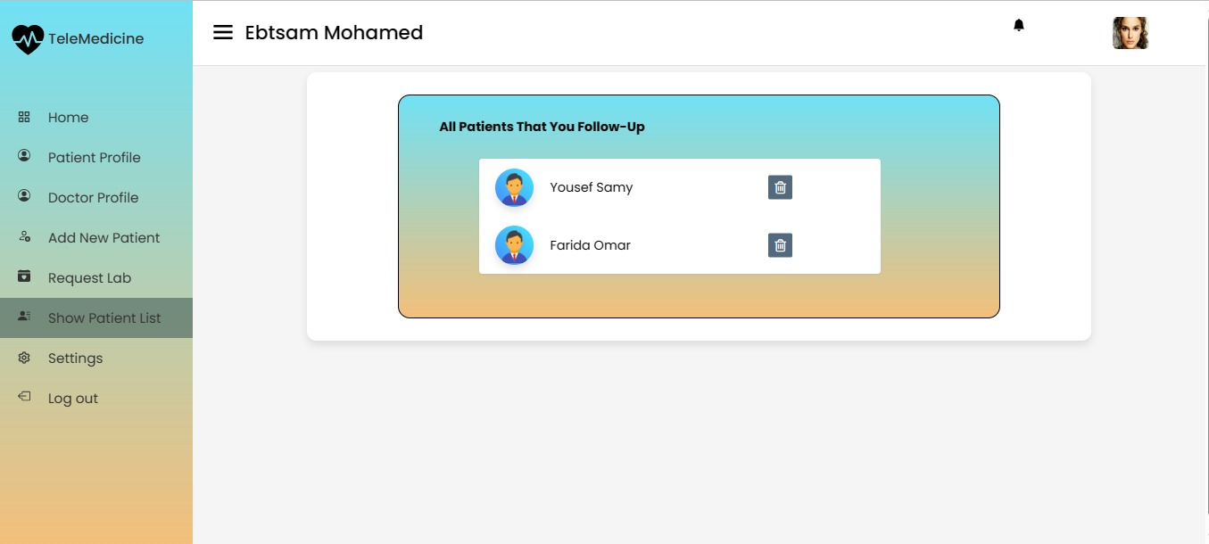
Manage your patient’s List
Asking for patient’s Permission before adding him!
Add more than 1 patient to follow

Slide 27
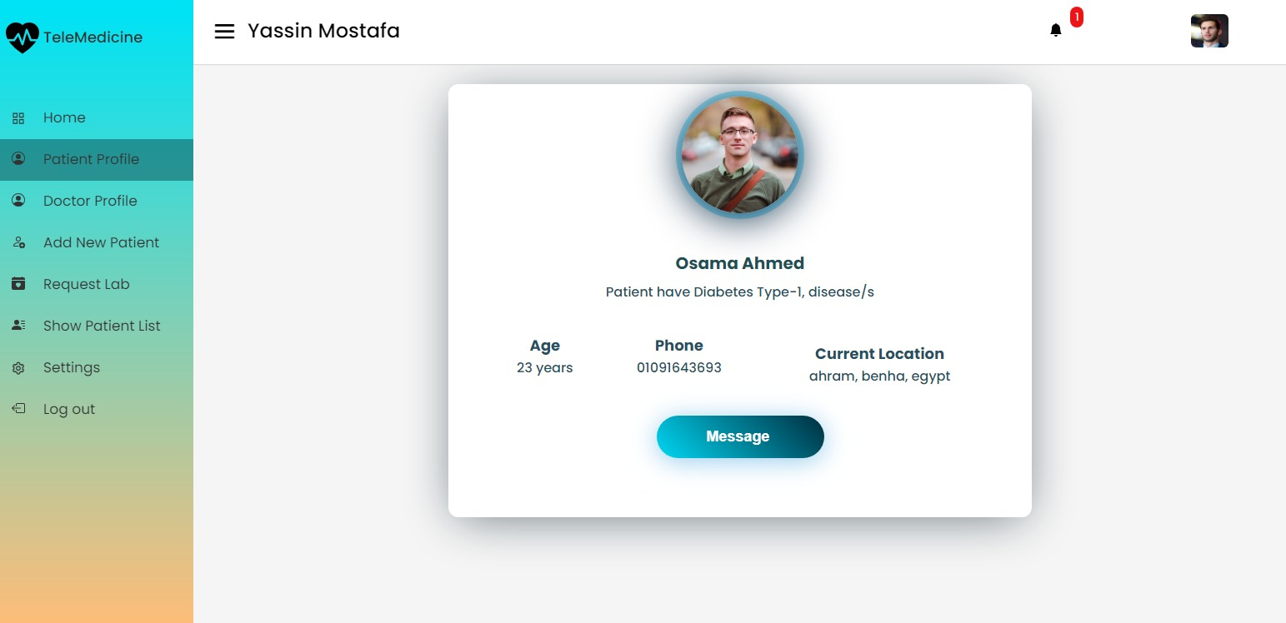
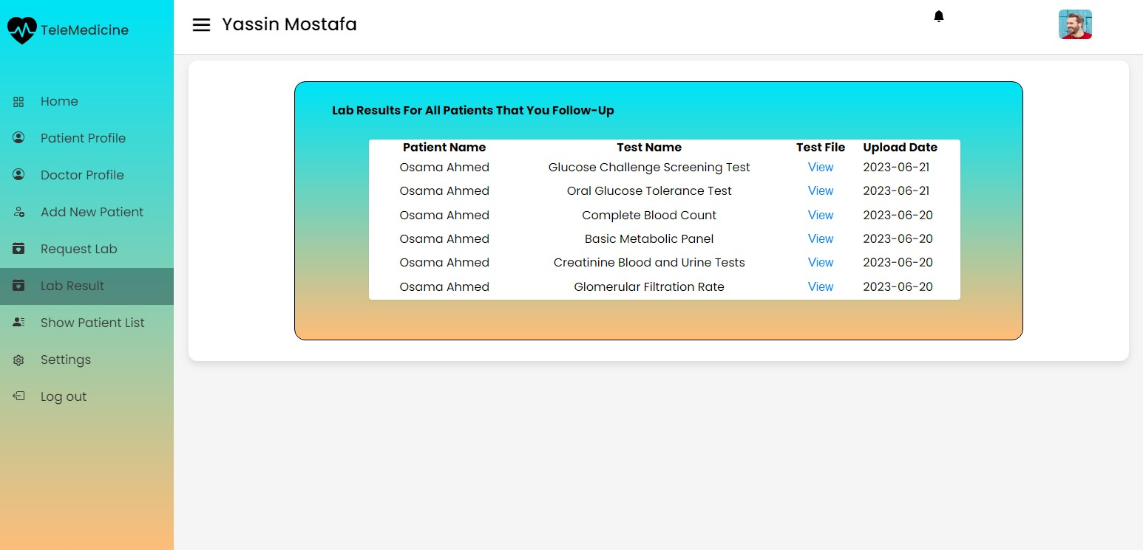
Show Your Patients
View your Patient Lab Tests

Slide 28
Patient
Interface
Sensors given to patient
Services
Relatives
Doctor
Interface
Machine Learning Model
Lab Tests

Slide 29
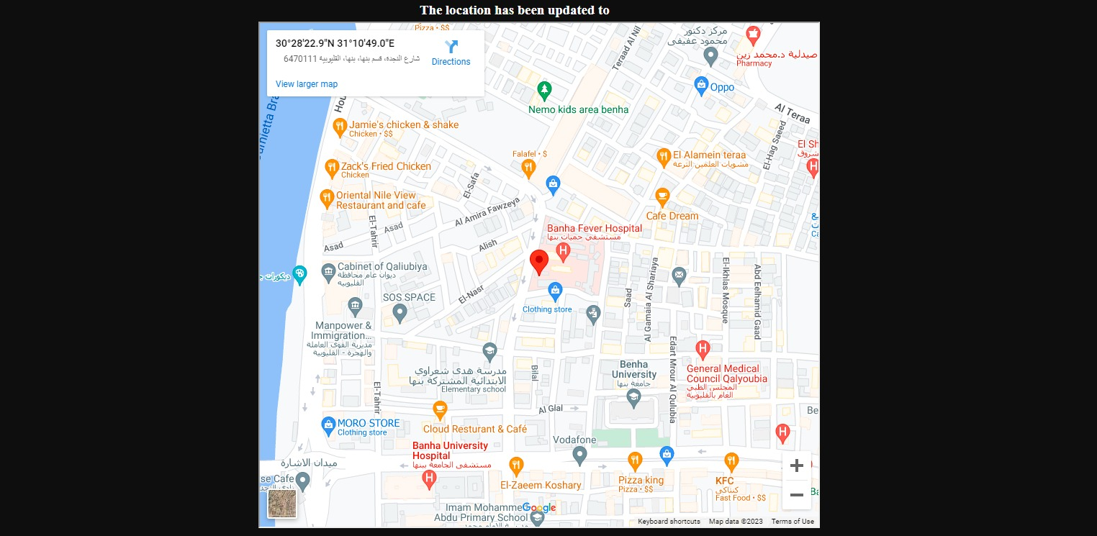
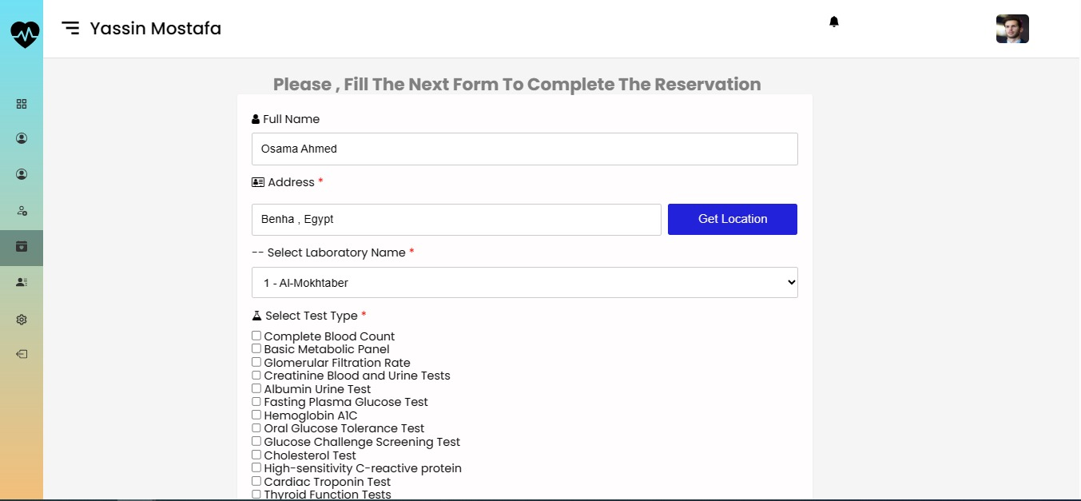
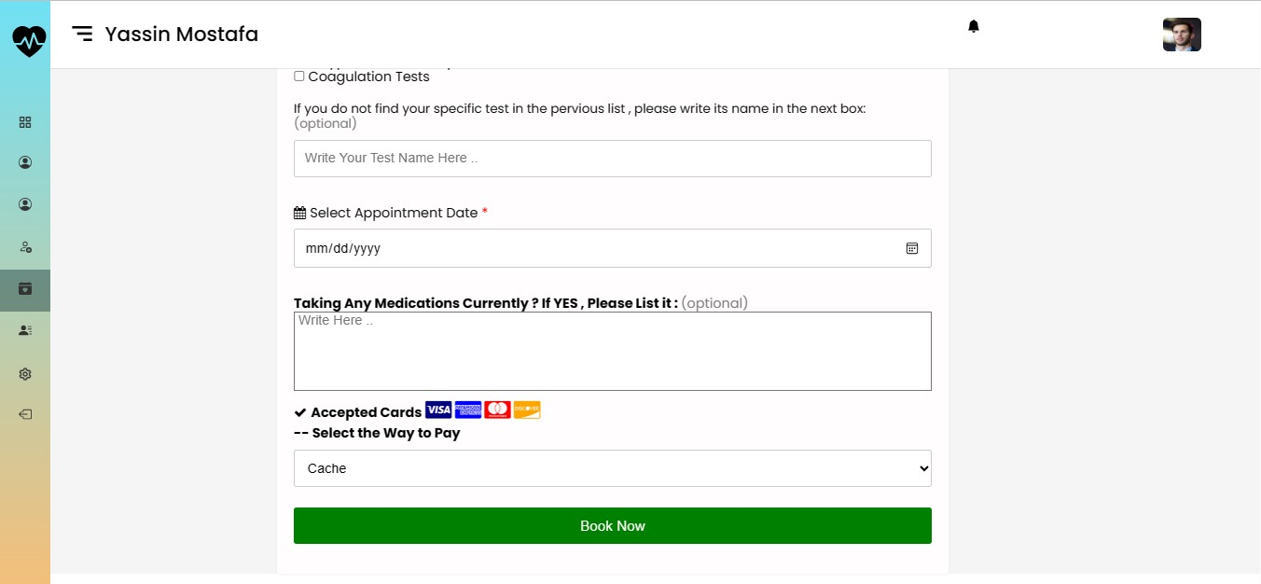
Request Lab Test
Register your lab tests easily
Choose Payment Method

Slide 30
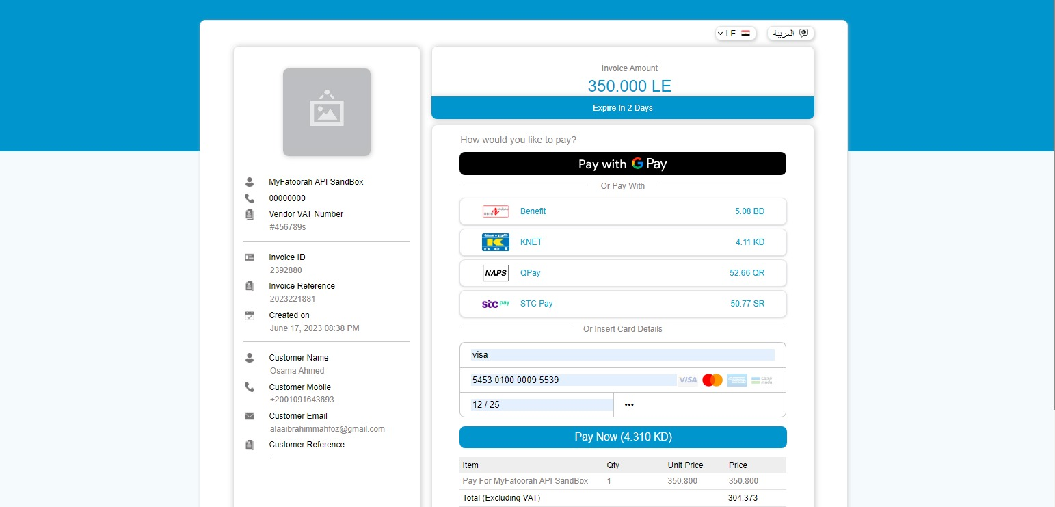
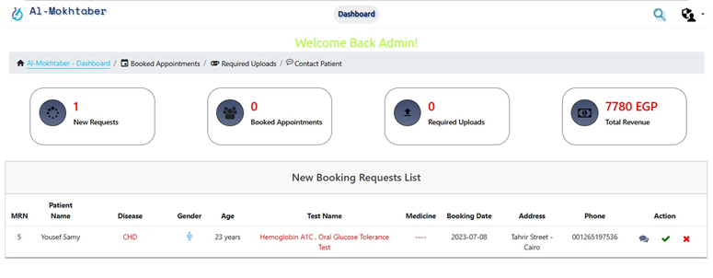
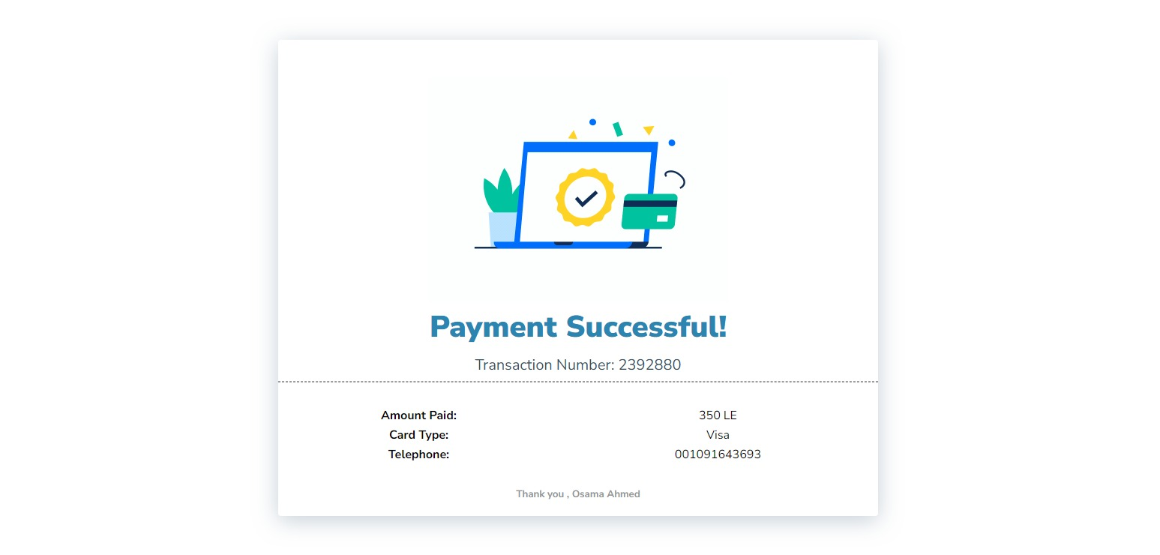
Lab Facilities
Payment Operation

Slide 31
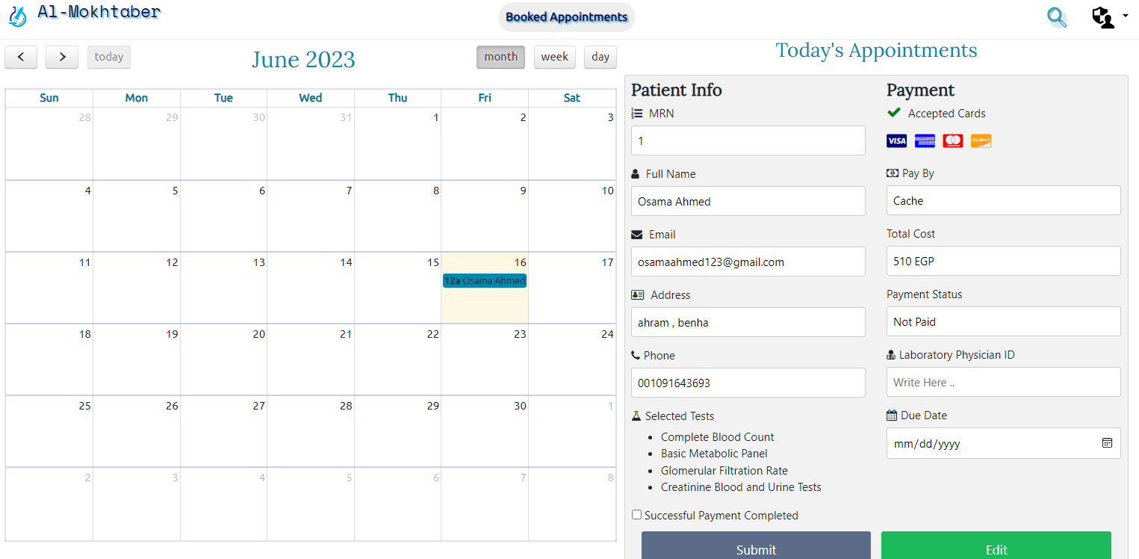
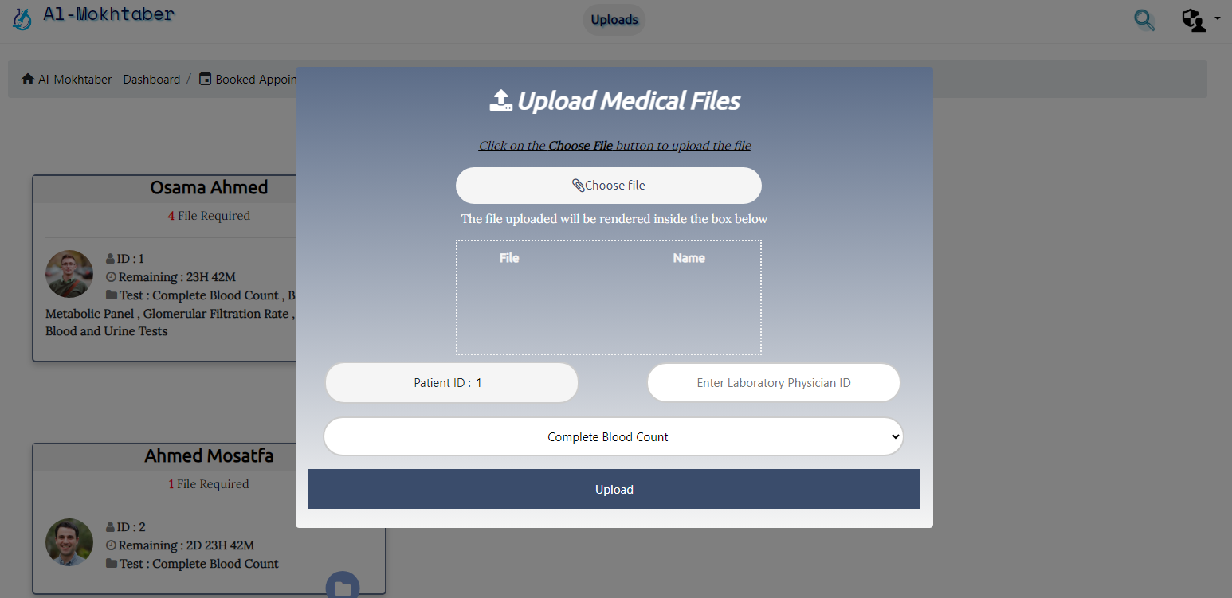
Lab Dashboard
Lab Admin Manages Requests & Sending Thechnician to patient’s Location

Slide 32
Patient
Interface
Sensors given to patient
Services
Relatives
Doctor
Interface
Machine Learning Model
Lab Tests

Slide 33
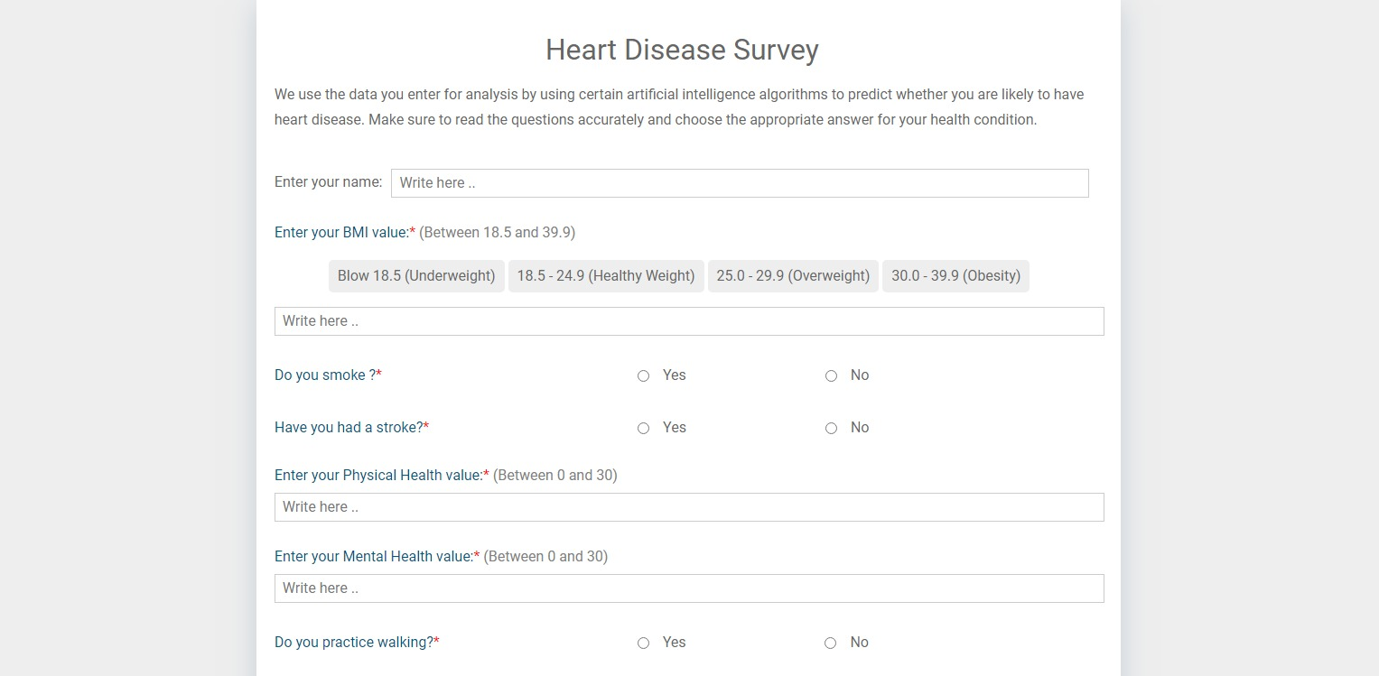
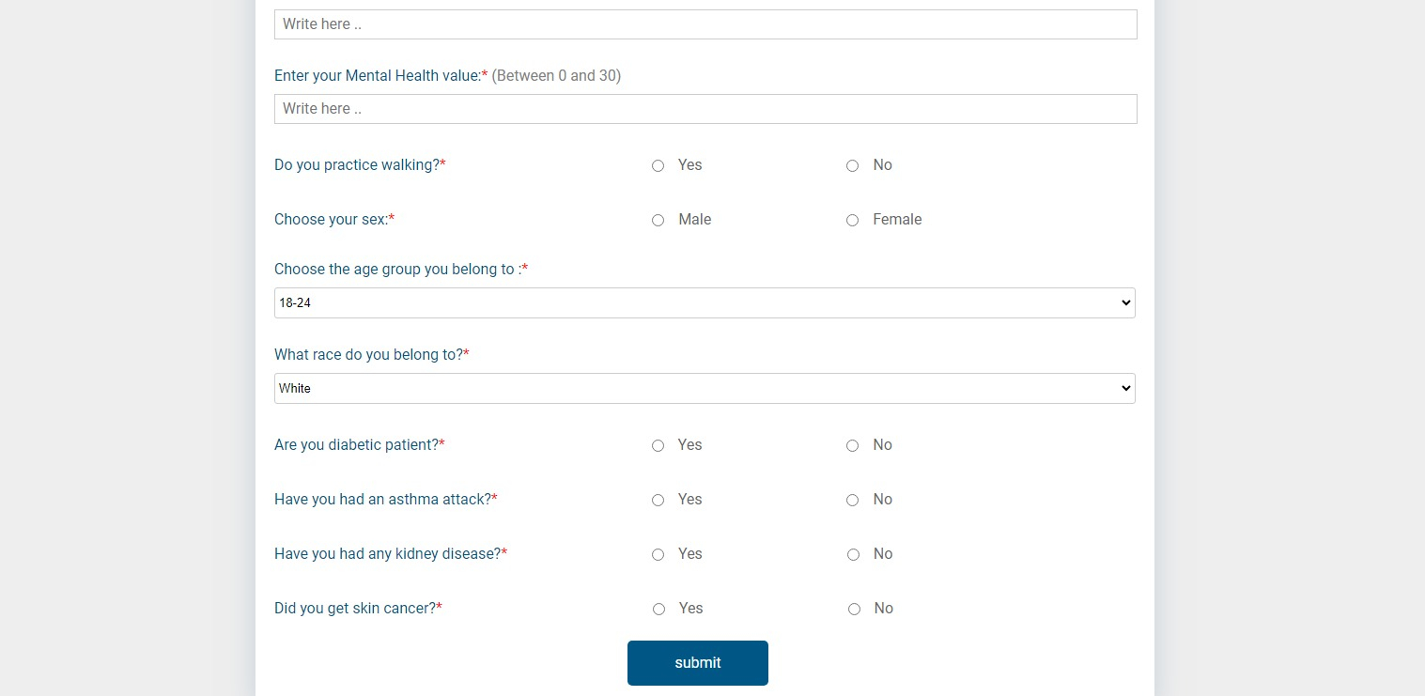
Machine Learning Model
Model to detect probability of getting Heart Disease
Fill the form to use the service

Slide 34
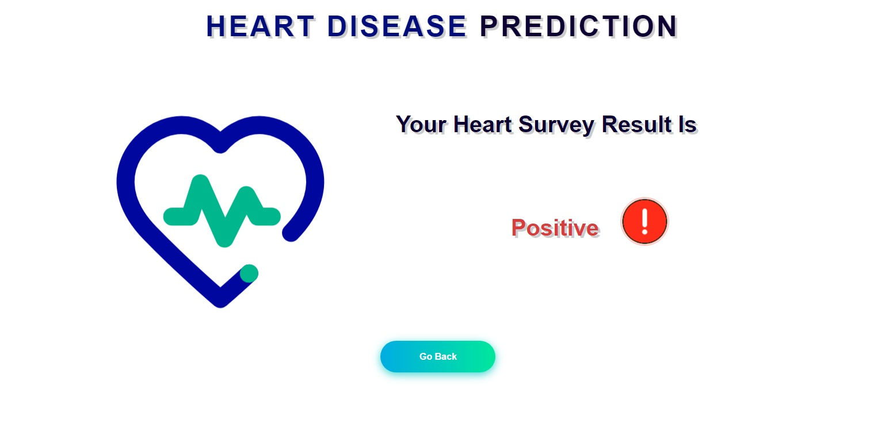
Model Result
Result Whether it is Positive or Negative

Slide 35
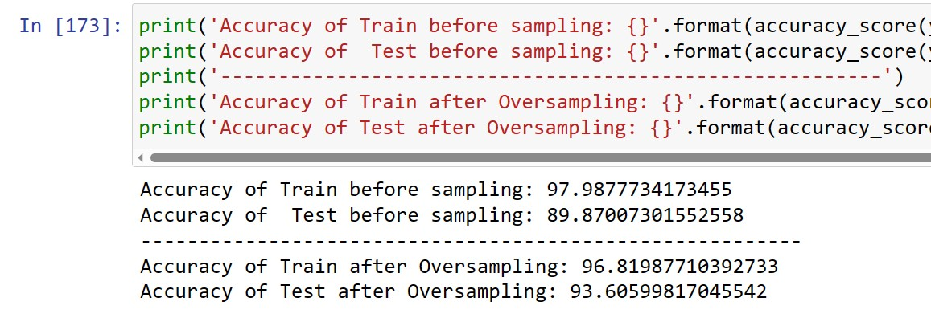
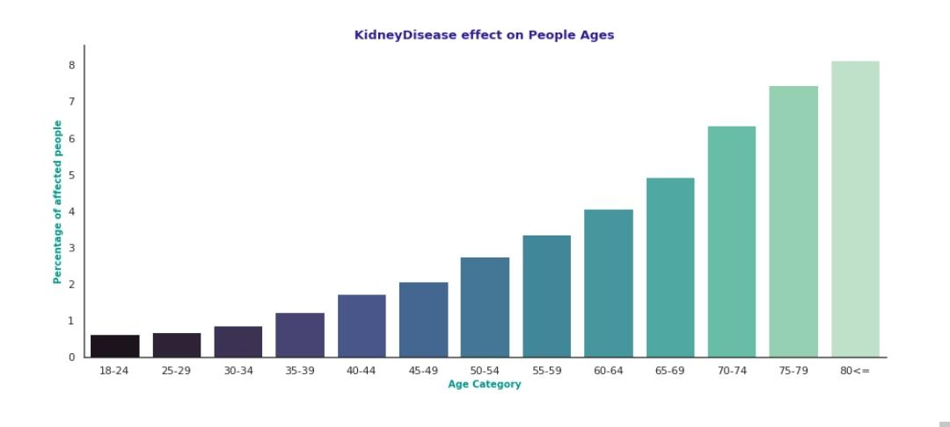
Model Accuracy
Model Accuracy reached 93.6%

Slide 37
Future Work
Add more Sensors
1
Mobile Application
2
3
More Health Care Facilities
4
Tracking Patient’s Location

Slide 38
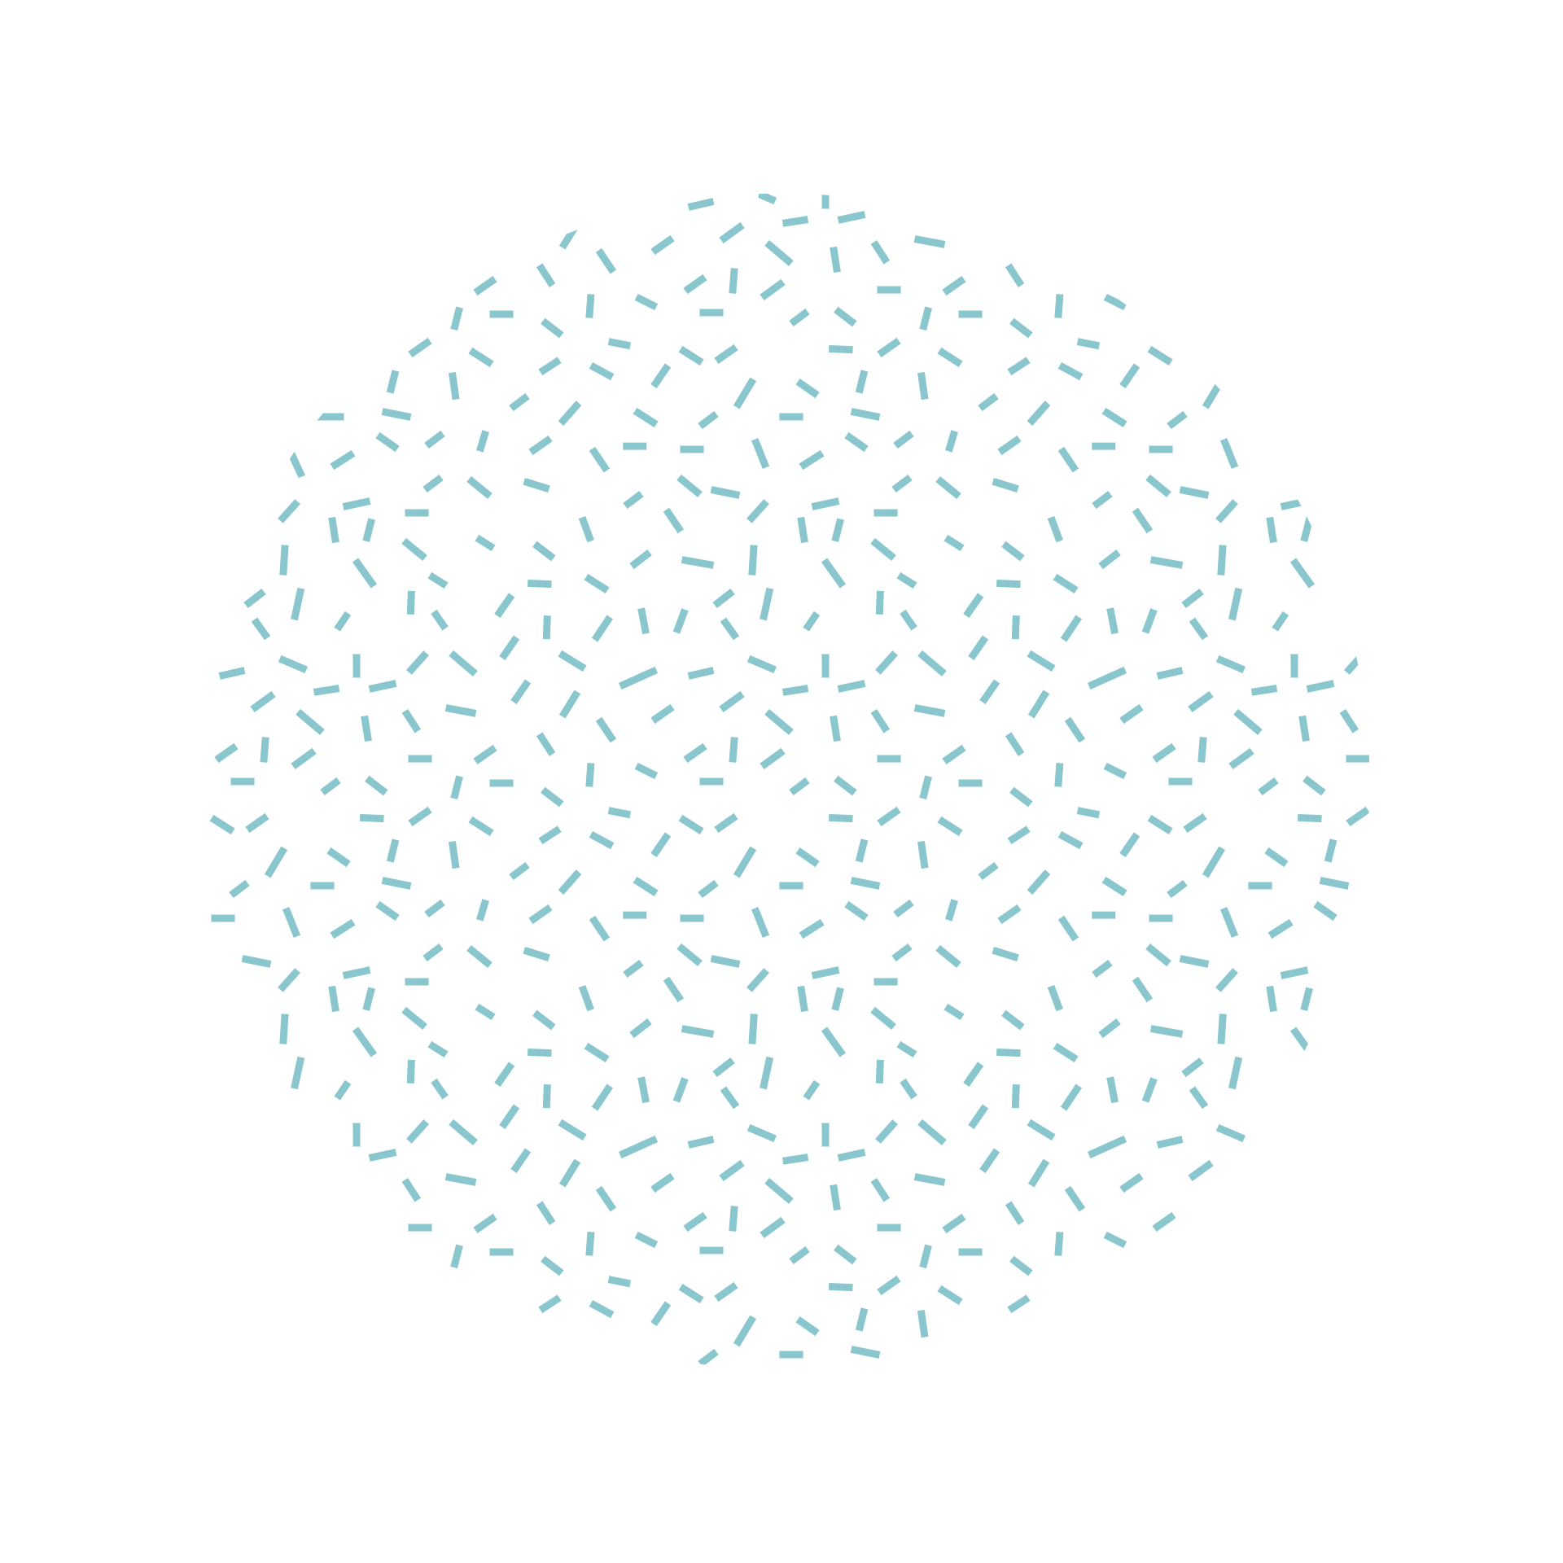

Thanks You

